Slide 1
Physical Computing
Raspberry Pi Pico and Micro-Python
2023

Slide 2
Lesson 3 Starter
Think pair share
Greeting someone by saying hello is an acceptable protocol.
What is a ment by the term protocol?
Notes:
In the context of computing and communication, a protocol is a set of rules or guidelines that dictate how data is transmitted and received between devices or systems. It defines the syntax, semantics, and synchronisation of communication, ensuring that different entities can understand and interpret the information exchanged. Protocols are essential for enabling communication and interoperability in various networking scenarios.

Slide 3
In this lesson you will learn
How to create a circuit for a 0.96 inch OLED screen on the Pico
How to program the Pico to output data to the screen
That protocols are needed to communicate between the Pico and the OLED screen

Slide 4
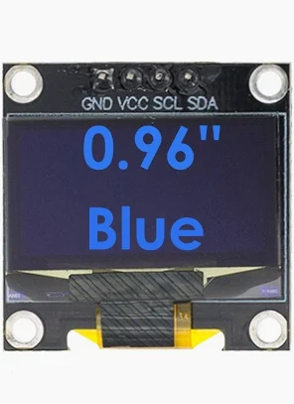
OLED Screens
OLED Organic Light Emitting Diode are popular for real world applications such as
Smart home devices, Washing machines, Microwaves, smart watches and other wearables,
They provide an option when you need a user to be able to read small amounts of output data
Notes:
Explanation of how tiny OLED screens such as the SSD1306 would be used in the real world on computing systems, these will help students to see the relevance of the device in relation to real world application
OLED displays are becoming increasingly popular in a variety of computing applications, due to their low power consumption, high contrast, and beautiful color representation.
Here are some specific examples of how tiny OLED displays like the SSD1306 are being used in the real world:
Tiny OLED displays are often used in embedded systems where space and power consumption are critical. For example, they are used in digital watches, fitness trackers, remote controls, smart home displays, security camera and medical devices.

Slide 5
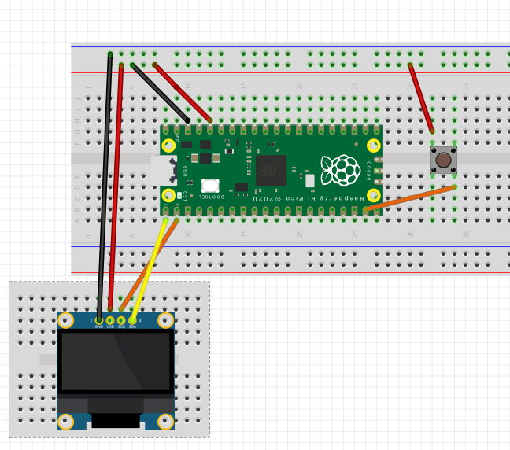
The Circuit
GND - Ground
VCC - 3v Rail
SCL - GPIO 1
SDA - GPIO 0
Notes:
A common error is to wire the clock and data pins incorrectly.

Slide 6
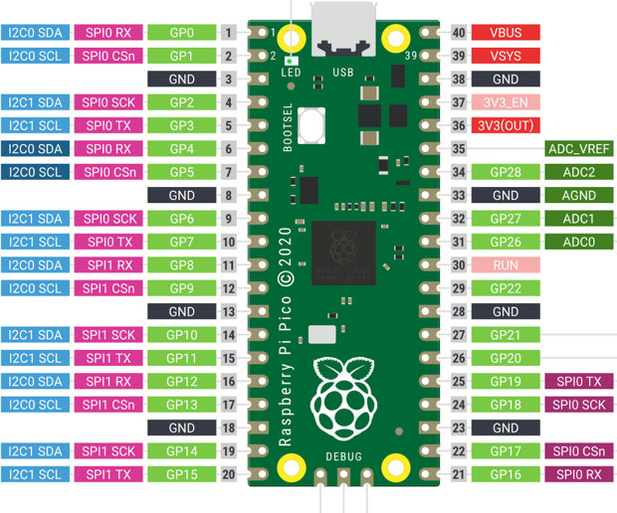
Pin out Diagram
Note how i2C pins are grouped in pairs
Pico has two Channels
0 & 1
Notes:
The Pico has two I2c channels 0 & 1. I2C is a protocol that is used to communicate with external devices

Slide 7

Use the circuit diagram worksheet to connect the OLED to the Pico

Slide 8

Lesson 3 PRIMM Activity
Look at the code on the starter code worksheet
What can you deduce from the code?
Annotate any code you recognise
Notes:
Give students time to digest the code before running the code to demonstrate the output
Import i2c is the protocol for working with a range of hardware using serial data transfer
I2c is assigned the protocol and the pins allocated to the protocol frequency can vary but it controls the cycle for the output) we will break this down later
Width and Height are constants that define the screen size in pixels
oled.fill(0) turn all pixels off to reset the screen
oled.text method to display text 0, 0 specify the coordinates in pixels of where the output should be placed
oled show is required to place the output on the screen

Slide 9
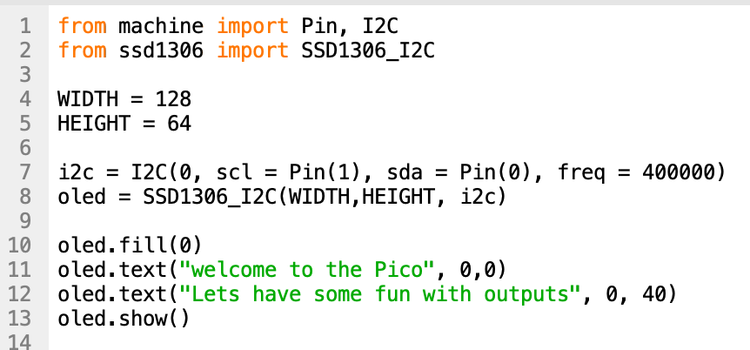
Let’s break down the code
Constants set the width and height of the screen
Create a I2c & a SSD object
Notes:
1.Line 1 I2C class is imported from the machine libary an I2C allowing for communication with I2C compatible devices, like the SSD1306 OLED display.
2.Line 2 from ssd1306 import SSD1306_I2C: This imports the SSD1306_I2C class, a specific driver for controlling the SSD1306 OLED display over I2C.
1.Configuration Constants:
1.WIDTH = 128 and HEIGHT = 64: These constants define the width and height of the OLED display in pixels.
2.line 7 i2c = I2C(0, scl=Pin(1), sda=Pin(0), freq=400000): This line line 7 initializes the I2C communication. It specifies the I2C channel (0 in this case the clock (scl) and data (sda) lines using pin numbers (1 and 0, respectively), and the communication frequency (400000 Hz, or 400 kHz). the frequency of the I2C communication clock, measured in Hertz (Hz). This frequency dictates how fast the data is transmitted over the I2C bus between the microcontroller Line 8 oled = SSD1306_I2C(WIDTH, HEIGHT, i2c): Here, an instance of the SSD1306_I2C class is created, which represents the OLED display. This instance is initialized with the width and height of the display, as well as the i2c object created earlier. This line prepares the OLED display for receiving data and commands.
2.Displaying Text:
1.oled.fill(0): This method call clears the display by filling it with 0 (black). The SSD1306 display is monochrome, so 0 represents black (off) and 1 represents white (on).
2.oled.text("Welcome to the PICO", 0, 0): This draws the text "Welcome to the PICO" at the coordinates (0, 0), which is the top-left corner of the display.
3.oled.text("Lets have some fun with output", 0, 40): This draws another line of text starting at the coordinates (0, 40). The y-coordinate 40 positions this line lower on the display, creating a visible separation from the first line of text.
4.oled.show(): Finally, this method updates the OLED display with all the operations performed since the last call to show(). It essentially "flushes" the drawing commands to the display, making the text visible.
When you run the code you will notice that some of the text will be off the edge of the screen you can discuss how the letters are made of pixels and the limiting size of 128x 64 individual. pixels takes a little planning when working with objects.

Slide 10

Task 1
SSD1306 is not a standard python built in library so we have to install via the manage package in Thonny.
Use the worksheet to guide you through the process
Notes:
An alternative method can be used to manually add the required files to the pico the SSD1306 file is in the code folder and once open a screen recording is also available to assist students in saving the file to the pico. Video demo is included in resources folder

Slide 11
Challenges
Can you program the OLED to change what is output to the screen when a button is clicked?
Use the sample code in the handout to experiment with the code
Notes:
For this activity you may want to distribute the starter code to students to run. Stronger programmers should have no trouble completing the code independently and undertaking the challenges.

Slide 12
Plenary
Notes:
Space is provided at the bottom of the OLED worksheet for students to define the following two key terms

Slide 13
Explain the term Mono OLED Screen
Notes:
A screen that is made up of tiny LEDS which when switched on can display only one colour

Slide 14
Define the term protocol
Notes:
An agreed method of communication between hardware

Slide 15
Homework
OLED is one type of technology used in screens. LCD is another popular display type.
Research LCD screen technology create a handout to explain your findings.

